Slide 1
WILDLIFE TREATMENT CREW
Summer Orientation
2015

Slide 2
What is WTC?
“Group of students and veterinarians at the UGA College of Veterinary Medicine committed to providing free medical treatment and care to injured wildlife.”

Slide 3
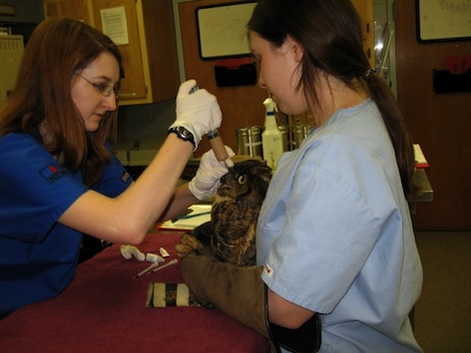
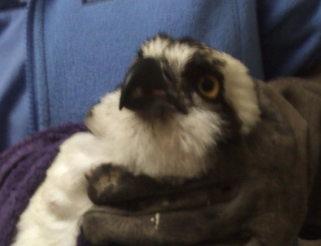
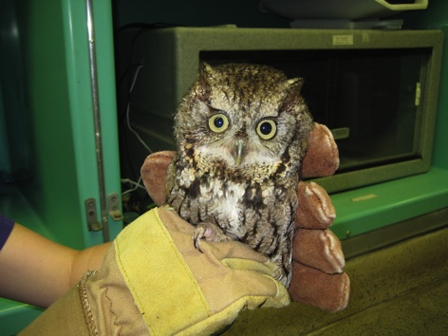
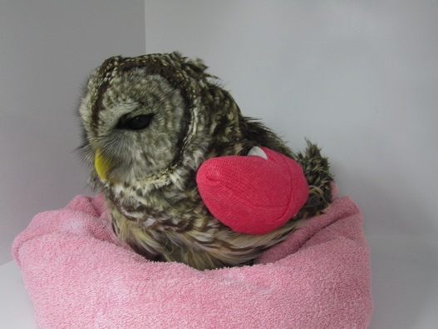
What kind of patients do we treat?

Slide 4
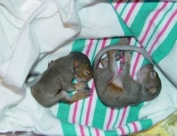
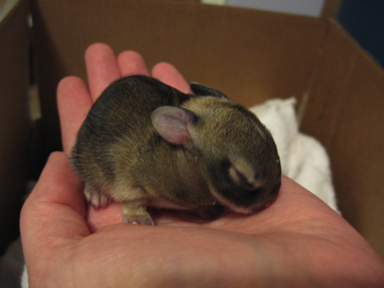
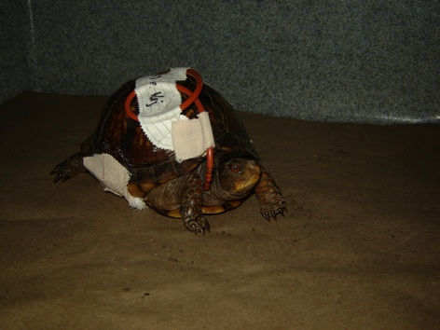
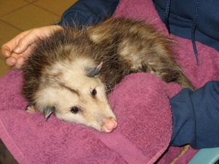

Slide 5
HOW DOES WTC WORK?
Injured wildlife
admitted to hospital
Patient treated for medical condition
Released back into wild
or
Transferred to a rehabilitation clinic

Slide 6
Syllabus!
READ IT!!!!!

Slide 7
WTC Members
Managers
Oversee operations, finances, etc.
Supervisors
Call in volunteers, assist members , oversee paperwork
Members
The “clinicians”
~YOU GUYS!~
SUMMER INTERNS!

Slide 8
Managers
Kaylee Quinn
John Rossow
Laura Burns
Clark Broughton

Slide 9
Where
New Vet School
ZooMed/ Exotics WARD
Wildlife Treatment
Area

Slide 10
Clinicians
Residents
Senior Students
WTC Students
WTC Intern
Who’s Responsible Here?

Slide 11
Clinicians
Dr. Divers
Dr. Mayer

Slide 12
Resident and Wildlife Intern
Izidora Sladakovic
Isabelle Desprez

Slide 13
Ashley Schuller: Technician

Slide 14
Senior Students
Senior students = 4th year vet students
Several senior students on the exotics block
Change every 3 weeks
Your go to person!
GET THEIR NUMBER

Slide 15
How does the hospital work?
Each case is assigned to a senior student
Senior is responsible for PE’s, Soap’s, and overseeing the case
Seniors present cases in rounds morning and evening
Which YOU should attend if you can!
Diagnostic and Treatment plans are determined by YOU, senior student and resident!
Communicate! Discuss diagnostics and therapeutics with your senior student every day!
YOU are responsible for PE, treatments, progress notes, discharges, and contacting rehabbers!

Slide 16
A Patient Comes In! What now?

Slide 17
What to expect
Someone will call you and your partner in!
Answer your phone or call back ASAP
Go to Clinic
Introduce yourself and find your patient!
Go from there
First few times- walk through the physical exam with your senior student to get acclimated
Once you are feeling comfortable you can begin a physical exam, come up with a treatment plan, and then discuss with a senior student!
It’s okay to be wrong!! This is a learning experience!

Slide 18
Treatments
*Once you have a patient, you and your partner will be responsible for treatments everyday!
* AM Treatments: Before 8:30am
*PM Treatments : Between (4 and 6)

Slide 19
Rounds
The Zoo Med Ward has rounds twice a day!
TRY TO ATTEND at least one of them!
Great learning experience and a way to stay involved with your case!
Difficult b/c times vary!
*Communication is key!

Slide 20
Taaaa daaaaa! Goodbye Turtle!
NOW WHAT?
Call a Rehabber!
Drive turtle to rehabber w/ intake form and discharge form!
DISCHARGE FORM: You will write up a synopsis of your case!

Slide 21
Paper Work- Smaper Work
Each patient has a file!
Intake Form
Physical Exam Sheet
Treatment Sheets
Any diagnostic sheets (Request for x-ray, blood results, etc)
Discharge form
Each patient has two numbers!
Wildlife ID Number
UVIS ID Number

Slide 22
*The Wildlife Log*
EXTREMELY IMPORTANT!!!!
This is how we track our patients!!

Slide 23
WTC WEBSITE
http://ugawtc.weebly.com
Username: ugawtc
Password: wtmember

Slide 24
Time Commitment
Variable! Depends on Caseload
Most cases stay in hospital only a few days but we do get long term patients.
Usually morning and evening treatments
Attend rounds if possible when you have a case assigned!

Slide 25
BIGGEST TIME COMMITMENT
Being on Call
Available Monday -> Friday 6am to 10pm
Don’t forget about your on call weekend!
Ready to RUN TO THE CLINIC at a moments notice!
You + Your Phone = Besties

Slide 26
Partners in Crime
A case always has two people assigned to it!
So you always have a partner!
You can split treatments and help cover each other if something comes up!
Help each other out! ☺
Contact information on the block schedule!

Slide 27
Block Schedule
Important document!
Highlights
Contact information for fellow interns
On call weekends
Case assignments
Please keep it updated!

Slide 28
Be Easy to Reach!
Write your number on the treatment sheet!
Write your number on the white board next to your patients number!
Communicate with you senior student to find out when things are happening (radiographs, surgeries, etc.)

Slide 29
Euthanasia
If you feel your patient is suffering, talk with your clinician!
Isoflurane and IV KCL

Slide 30
Rabies Vectors
Rabies vectors are not admitted to the hospital!
If accidently they are, do NOT handle them.
Please review the rabies protocol sheet in the syllabus!

Slide 31
Parking
You CAN NOT park at the hospital between 7am and 5pm Monday through Friday!
After 5 M-F is okay and anytime on weekends!
Several options:
Park on campus and shuttle in
Park at church (?)
Walk/Bike to the hospital

Slide 32
House Keeping
What to wear?
Look presentable!
Closed toed shoes and pants!
Scrubs are great too!
Clean up after yourself!
We are Non-Profit -> No Money -> please consider this when coming up with treatments!

Slide 33
Things to keep in mind
The doctors are busy treating client owned animals!
Please respect them and “stay out of their way” when things are hectic!
Feel free to read the treatment sheets of the exotic pets in the ward and ask questions.
But please don’t touch them!
YOU are the patients number one caretaker!
Pat attention to the details!

Slide 34
Questions?

