Slide 1
Example Case
Eastern Screech Owl HBC

Slide 2
You get to clinic and find…

Slide 3
Intake Form
Owl found by side of the road 30 minutes ago. Lethargic but attempted to get away. Did not feed anything.
Found at: Barnett shoals and Old Lexington

Slide 4
What do you do now?

Slide 5
Physical Exam Form!

Slide 6
This is the Physical Exam form!

Slide 7
Singlement
Adult
Eastern Screech Owl
Sex unknown

Slide 8
Findings….
QAR
Depressed mentation
Weight: 151g
HR: 200bpm
BCS: 3/5
Mucous Membrane: tachy,
Abnormal Findings:
Sm abrasion noted over mid wing (mid humerus).
Palpated but unable to determine if fractured or not
Eye cloudy and not open

Slide 9
Next step?
Fluids
Pain meds
Antibiotics
Set up cage
- Create a plan with your senior student!

Slide 10
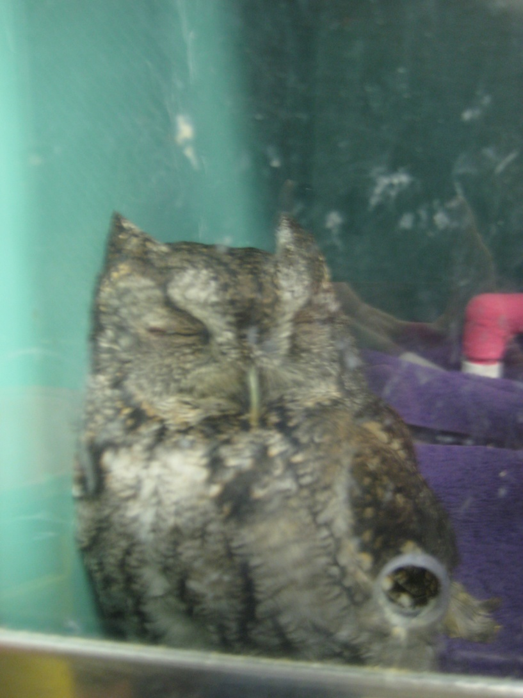
Treatments for the Night
6mls LRS SQ
.02ml .5mg/kg Metacam IM in left pectoral
Offered 1 mouse
Placed in incubator on oxygen overnight

Slide 11
What should you do before you leave for the night?

Slide 12
Paperwork and House Keeping?
Put intake form and PE sheet in File
Put file in slot on wall.
Put Species, WTC Case Number, and UVIS sticker on all papers!
Update the Wildlife Log

Slide 13
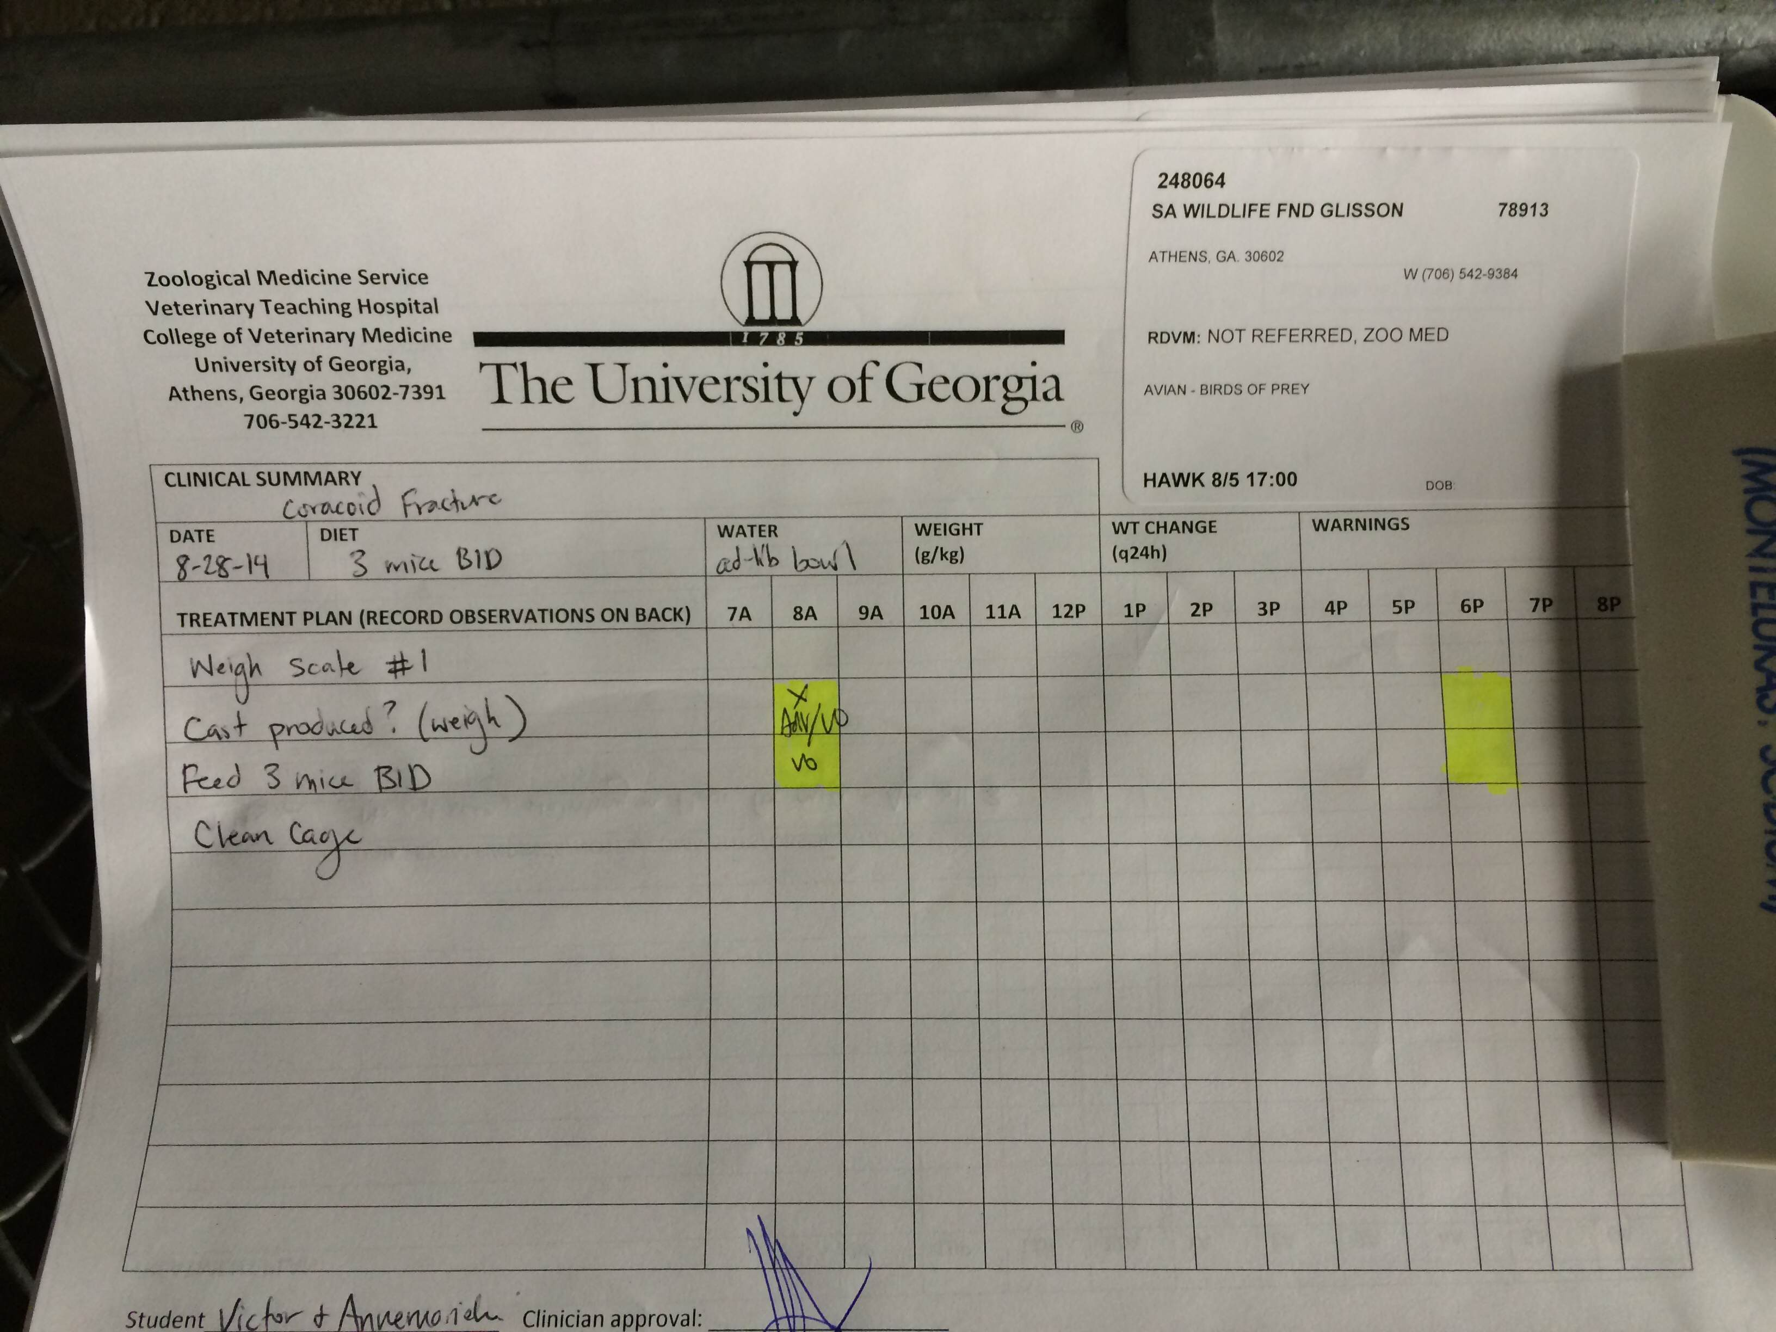
Treatment Sheet
Write up treatment sheet
For today’s treatments
And make new one for tomorrow!
Put a UVIS sticker on every paper! Get them from the patient’s folder. If out of stickers, see the front desk.

Slide 14
House Keeping
Put your case number, species, name and cell on the whiteboard!
Change the “Next Wildlife Number” on the dry erase board!

Slide 15
House Keeping
Assign box and put medications here!

Slide 16
What else before you leave?
Paperwork done?!
Housekeeping done?
Communicated with partner?
DONE!

Slide 17
What more do you want to know about your bird?
The next day….

Slide 18
Consults
Radiology
Ophthalmology
X-Rays revealed no fractures!!
Small laceration on third eyelid in the right eye
Inflammation in both eyes

Slide 19
Daily Treatments
What should go on the treatment sheet?
What kind of medicines do we want him on?

Slide 20
Treatments
Weigh SID
Feed: 1/2 mouse BID
Water: ad lib
Fluids: As needed, assessed daily
Clean Cage SID
(OU Flurbiprofen (NSAID),
1 drop, administered TID at 8am, 2pm, and 8pm
OD Tobramycin (antibiotic)
1 drop, administered BID at 8am and 8pm
.02 mL of 0.5mg/kg Metacam (NSAID)
given orally or inside ½ mouse BID
0.1mL TMS (antibiotics)
administered orally or inside ½ mouse SID at 2pm

Slide 21
Recording our Progress
Record what you did and what you observed after every treatment!
Write on the back of the treatment sheets!
Example:
- 04/22 8am: Patient was BAR and perching. Backed into corner to avoid being handled. Ate ½ of mouse overnight. Knocked waterbowl over. Weight has increased .05 from yesterday. Did not administer SQ fluids. Gave Flurbiprofen and Tobramycin. Put TMS and Metacam in ½ mouse and put in cage. Patient ate mouse 15minutes later.

Slide 22
Four days later…
Ophthalmology check up
Laceration healed!
Small amount of Inflammation still present
Not ready for release
Eating well
Maintaining weight
BAR during treatments

Slide 23
Eight days later
Ophthalmology console
Right eye improved
Inflammation greatly reduced!
BAR and very active!
READY TO GO!!!

Slide 24
Clear for Take Off!
Call Rehabbers!
Find a place for him to go!
Transport to Rehabber!

Slide 25
Discharge Form
Write up Discharge.
Enter into Uvis.
Get doctor to approve it.
Put form in file.
Send a copy with rehabber.

Slide 26
Don’t Forget!
Complete the wildlife log entry!
Make sure all paperwork is complete and in the file!
Your cage is clean and your drugs are put away!

Slide 27
The owl died?
What if…….
-How would discharge stuff work?
Notes:
The same! We must complete discharge forms for everyone!!!!

