Slide 1
Caring for Infant Squirrels

Slide 2
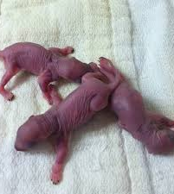
How old is your squirrel?
Refer to website

Slide 3
Keep your babies warm
Never feed a cold squirrel!
Digest better when warm!
Before feeding your squirrel, it must reach 98 degrees.
Ways to warm them up
Regulate temperature in cages
Warm up old fluid bags

Slide 4
Hydration
Access the dehydration status
Skin turgor test
Are they thin, lethargic, unresponsive, cold,or weak?
What is there general body color?
Are they urinating?
Is the urine thick and dark yellow?
Rehydrate your baby FIRST!
Do not start the baby immediately on formula!
Rehydration and digestion cannot take place at the same time!
Rehydrate using SQ injections of Lactated Ringers

Slide 5
Initial rehydration and formula introduction schedule
*** Based on 3cc syringe- adjust accordingly
Feeding #1
½ cc formula and 2 cc’s of plain water.
Feeding #2
1 cc of the formula - add 2 cc's of plain water.
Feeding #3
1 and 1/2 cc's of the formula - add 1 and 1/2 cc's of plain water.
Feeding #4
2 cc's of the formula - add 1 cc of plain water.
Feeding #5
2 and 1/2 cc's of the formula - add 1/2 cc of plain water.
Feeding #6
You have reached full strength formula which you will continue to feed

Slide 6
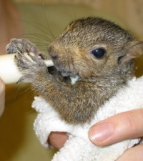
What do you feed?
Esbilac Powder
1 part powder: 2 parts water
Can add 1 part whipping cream
Incentive to eat? More calories?

Slide 7
How much do you feed?
Based on weight
20 gram squirrel – 1 cc of esbilac formula
100 gram squirrel – 5-7 cc
200 gram squirrel – 10-14 cc
Generally
Feed 5% of body weight per feeding
Notes:
Eyes closed
5% of body weight at each meal
Eyes open (This means they are over 4 weeks!)
5-7% of body weight at each meal

Slide 8
How Often To Feed
Check stomach size before every feeding!
Age in weeks | Number of feedings per day
0- 1 | 8
2-3 | 6
4 | 5
5- 6 | 4
7-8 | 3
8- 12 | Transitioning to solid foods!

Slide 9
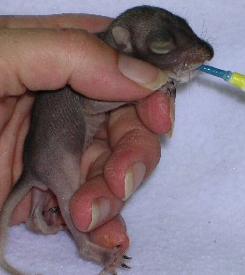
Proper Feeding tid bits
Proper position
Upright position
Allow it to grasp syringe if it desires
Cover eyes
STOP feeding if
Formula bubbles out of nose, lower head to allow fluid to run out.
To feed use a…
1 cc syringe for pinkies
3 cc syringe for 3-5 weeks
6 cc syringe for 5-6 weeks

Slide 10
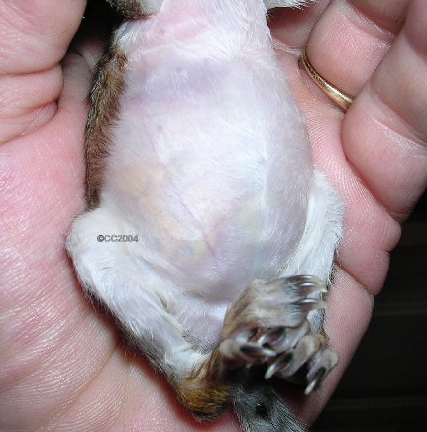
Bloat
Bloat occurs because…
Fed an improper formula
Overfed
If baby bloats, DO NOT feed until bloat resolves!

Slide 11
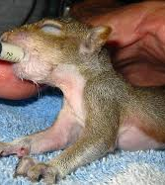
Bathroom Business
Stimulate to urinate and defecate every time you feed if eyes still closed!
To stimulate use a warmed, moist paper towel and apply light, feathery strokes over genital area.
***Check for inappropriate suckling!

Slide 12
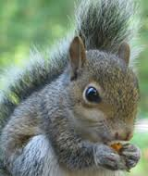
Weaning
At around six weeks of age begin offering solid food!
Veggies and fruit such as apples, grapes, broccoli, and sweet potatoes.
Squirrel should continue on formula until around ten weeks old.
Once squirrel is consuming a good amount of solid food, start cutting back feeding.

Slide 13
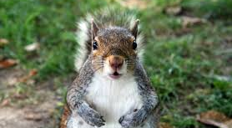
Questions?

