Slide 1
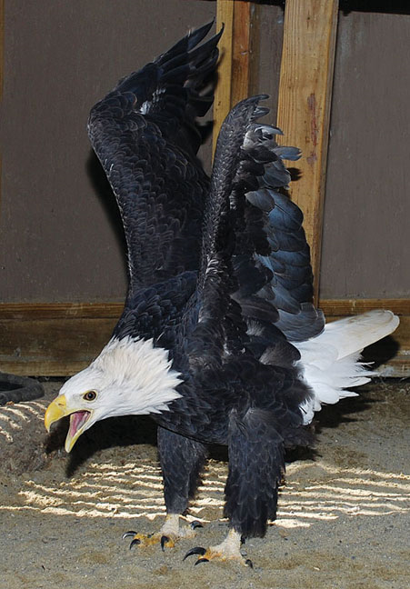
Anatomy of Avian Thoracic and Pelvic Limbs
Presented 04/01/2013
Presented by: Christina G Handford

Slide 2
Name Those Bones – Thoracic Limb
Major Metacarpal (MC II)
Major Digit (II) (Prox. & Dist Phalanx)
Alula (Digit I)
Humerus
Radius
Minor Digit (III)
Minor Metacarpal (MC III)
Ulna
Shoulder Joint with Humerus, Scapula, Clavicle, and Coracoid
Wrist Joint (Carpus)
Metacarpal-Phalangeal Joint
Elbow Joint
Notes:
Propatagium – webbing above elbow from shoulder to carpus

Slide 3
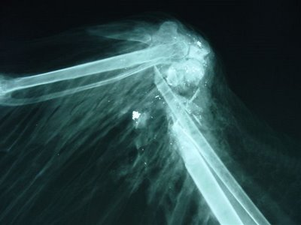
Practice – Where is the Fracture?
Major MC (II)
Alula
Carpus
Radius
Minor MC (III)
Ulna

Slide 4
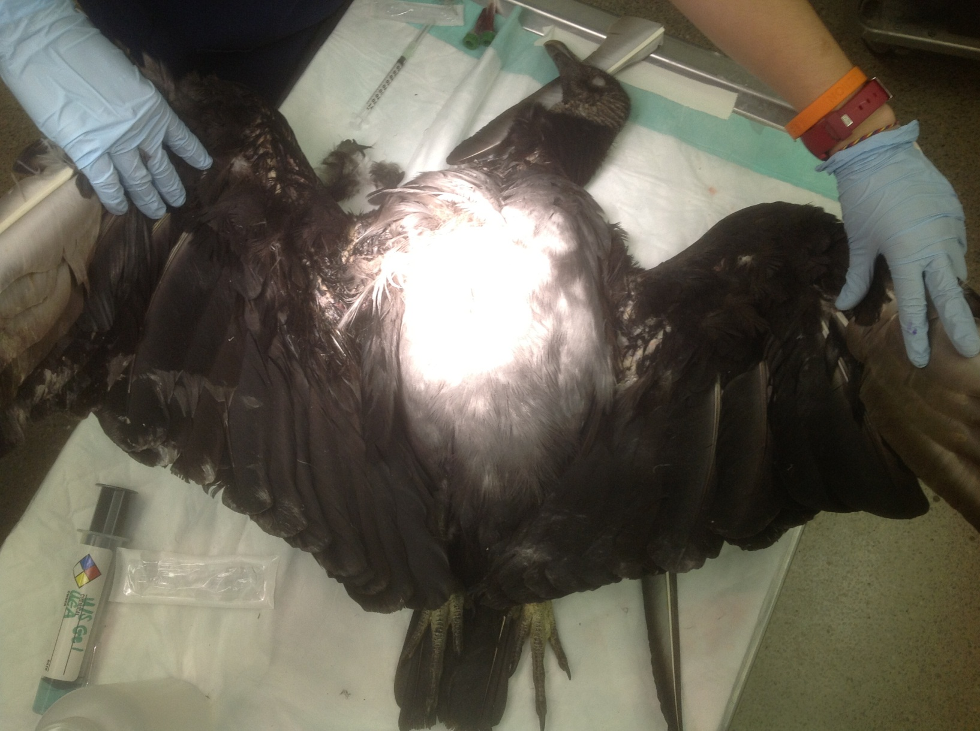
What About With Feathers?
Humerus
Radius and Ulna
Alula, MC, Phl
Notes:
Black Vulture Coragyps atratus

Slide 5
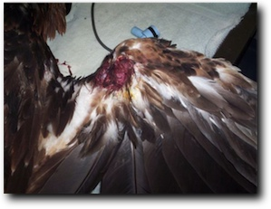
Feathered Injuries
Carpus
Radius/Ulna
Describe the Location of this Injury
Distal end of Radius/Ulna, proximal to the Carpus

Slide 6
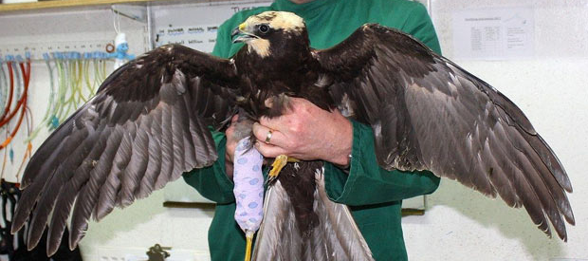
Practice?
Radius/Ulna
Metacarpals
Elbow/Humerus
Radius/Ulna
Metacarpals
Elbow/Humerus
Notes:
Marsh Harrier Circus aeruginosus

Slide 7
What’s Missing???
Carpus
Carpus?
Elbow Joint?
Notes:
Bald Eagle Haliaeetus leucocephalus

Slide 8
Name Those Bones – Pelvic Limb
Femur
Knee Joint
Fibula
Tibiotarsus
Hock Joint
Tarsometatarsus
Digit I (2 Ph.)
Digit III (4 Ph.)
Digit II (3 Ph.)
Digit IV (5 Ph.)
Craniocaudal View
MedioLateral View

Slide 9
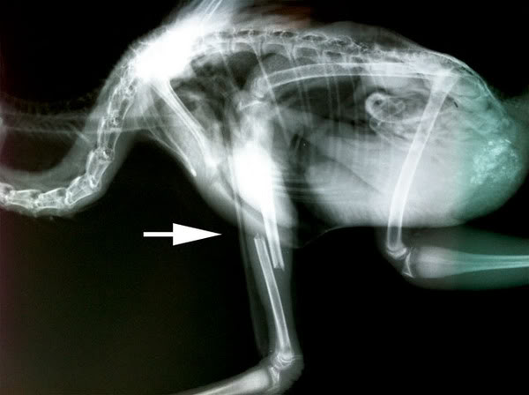
Practice – Where is the Fracture
Femur
Tibiotarsus
& Fibula
Knee
Hock
Tibiotarsus

Slide 10
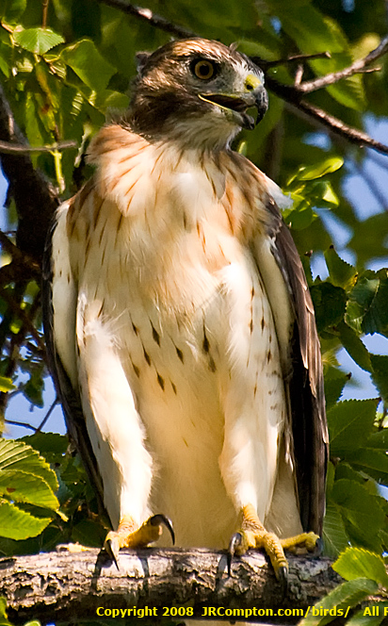
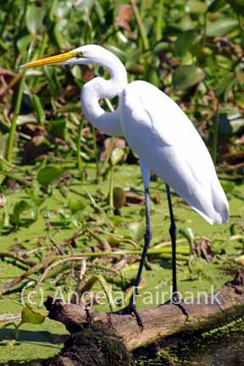
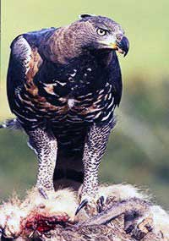
What About With Feathers?
Tibiotarsus and Fibula
TarsoMetatarsus
Digits!
Notes:
Left: Great Egret Ardea alba Middle: Red-tailed Hawk Buteo jamaicensis
Top Right: Mockingbird Mimus polyglottos Bottom right: Crowned Eagle Stephanoaetus coronatus

Slide 11
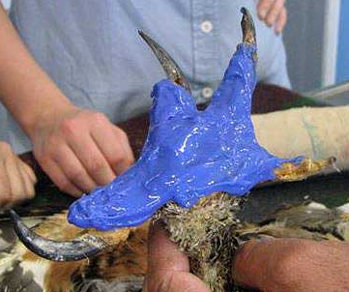
More Digits
Digit III – 4 Phalanges
Longest Digit
Digit II – 3 Phalanges
Digit IV – 5 Phalanges
Digit I – 2 Phalanges
1st Metacarpal Bone

Slide 12
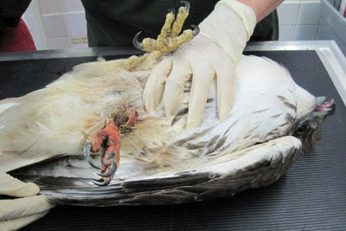
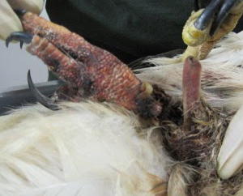
Feathered Injuries
Proximal to Mid Tibiotarsus
Distal Tarsometatarsus
Describe the Location of These Injuries
Notes:
Left: Black Headed Gull Chroicocephalus ridibundus Right: Red Tailed Hawk Buteo jamaicensis

Slide 13
Practice?
Tibiotarsus
Digits
Tarsometatarsus
Digits
Tarsometatarsus
Tibiotarsus
Notes:
Red-tailed Hawk Buteo jamaicensis

Slide 14
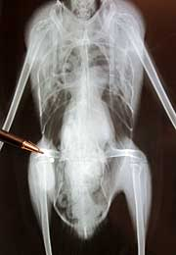
What Happened to the Femur?

Slide 15
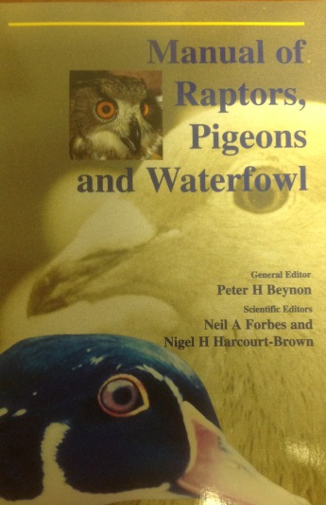
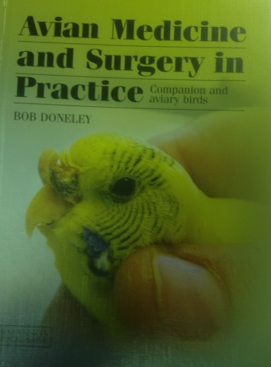
Acknowledgements
Dr. Fava
Dr. Proença
Dr. Divers
Dr. Mayer
ZooMed Ward Senior Students
Wildlife Treatment Crew Managers/Supervisors
Paula Rodriguez
UGA CVM Library
Google

Slide 16
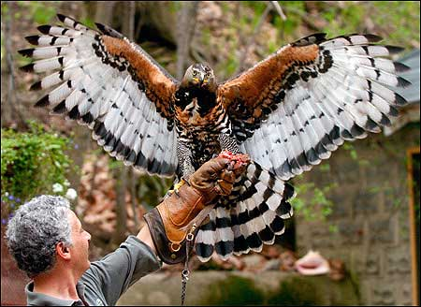
Any Questions?
Notes:
Crowned Eagle Stephanoaetus coronatus

